Slide 1
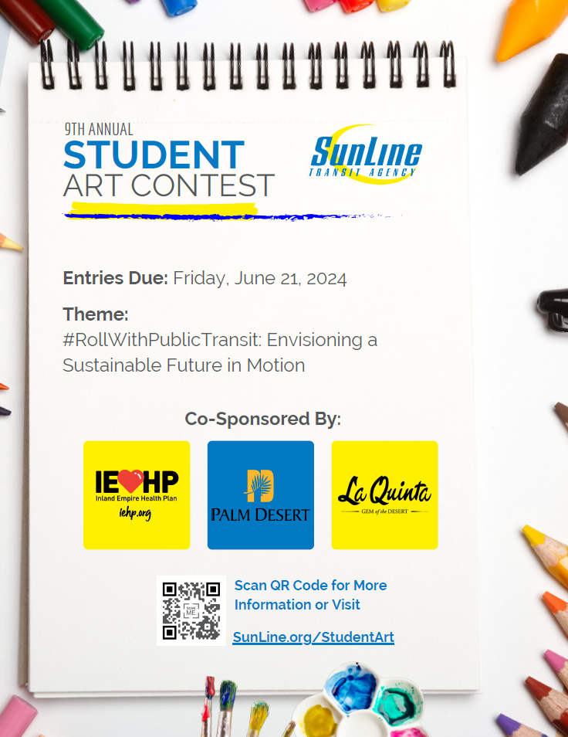

Slide 2

SunLine Student
Art Contest
Theme: “#RollWithPublicTransit: Envisioning a Sustainable Future in Motion”
As a leader in alternative fuel solutions, SunLine’s buses are all environmentally friendly. Our 9th Annual Art Contest is a way for our local youth to learn more about the advantages of clean energy and the public transit system. Enter a design for a chance to have your artwork on the side of a zero emission bus. Contest is open to public school, private school and homeschooled students local to the Coachella Valley only. Please read below for contest rules for each grade level:
CONTEST RULES FOR ELEMENTARY SCHOOL STUDENTS (GRADES K-5th) AND
MIDDLE SCHOOL STUDENTS (GRADES 6-8th):
Artwork may include crayons, paint, markers, or colored pencils. No digital media accepted.
Art should include buses and landmarks that are unique to the Coachella Valley (for example: windmills).
The SunLine logo must appear on any drawings of buses or public transit vehicles.
Artwork MUST include a written message about how public drives future sustainability for the environment and should be incorporated into the design. Keep text away from edge of poster.
All words must be spelled correctly.
The back of the poster must include the following information and it must be legible: student’s full name, contact phone number, email address, grade level, school name, and teacher’s name.
Each student may submit only one poster design. The design must be original work created by the student. The poster must measure 8.5 x 11” wide. The design should be laid out horizontally and submitted on regular paper or heavy paper such as poster or card stock.
CONTEST RULES FOR HIGH SCHOOL STUDENTS (GRADES 9-12th):
Artwork may be composed of digital media (photography, graphic design) or traditional artwork (paint, markers or colored pencils).
Art should include buses and landmarks that are unique to the Coachella Valley (for example: windmills).
The SunLine logo must appear on any drawings or photos of buses or public transit vehicles.
Artwork MUST include a written message about how public drives future sustainability for the environment and should be incorporated into the design. Keep text away from edge of poster.
All words must be spelled correctly.
The back of the poster must include the following information and it must be legible: student’s full name, contact phone number, email address, grade level, school name, and teacher’s name.
Each student may submit only one design. The design must be original work created by the student. The design must measure 8.5 x 11” wide. The design should be laid out horizontally and submitted on regular paper or heavy paper such as poster or card stock.
ENTRIES DUE: FRIDAY, JUNE 21, 2024
VISIT SunLine.org/StudentArt FOR COMPLETE CONTEST RULES

Slide 3



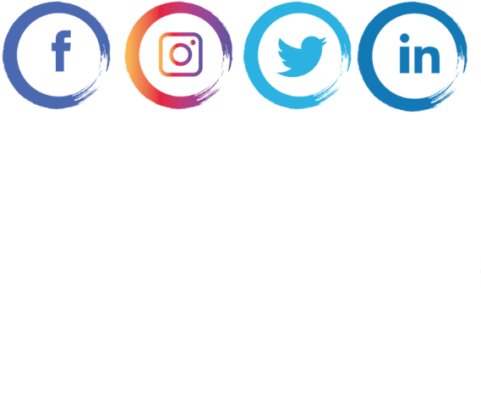
SunLine Student
Art Contest
IMPORTANT INFORMATION ABOUT SUBMISSION:
Submission: Upload artwork images at www.SunLine.org/StudentArt, mail to SunLine or drop-off at 32-505 Harry Oliver Trail, Thousand Palms, Ca 92276 no later than 5 p.m. on Friday, June 21, 2024
Keeping Artwork: All students MUST keep their physical artwork submission until the results have been announced. The finalists will need to mail or drop-off their artwork at SunLine. This is a requirement to have your artwork placed on a bus or bus shelter.
WINNER ANNOUNCEMENTS:
A winner will be determined from each of the grade level categories for a total of three (3) first place winners.
The first place winners will have their artwork fully wrapped on a hydrogen electric fuel cell bus. The winning entry will also be posted on SunLine’s website, SunLine.org, or other printed/digital materials. The second and third place winners will have their artwork displayed at a local bus shelter in the Coachella Valley.
ADDITIONAL DETAILS:
All artwork becomes the property of SunLine Transit Agency and may be used for advertising, sales or promotional purposes that may include regional media coverage with appropriate credit to the artist. By entering the contest, you consent to have your name and photograph appear as one of the winners.
For more information about the contest, please contact Carmen Cubero by email at
studentart@sunline.org or phone 760-343-3456 Ext.1105.
Visit SunLine.org/StudentArt for downloadable fact sheets and informational videos.
Be sure to follow us on social media, @SunLineTransit, for artwork inspiration!
ENTRIES DUE: FRIDAY, JUNE 21, 2024
VISIT SunLine.org/StudentArt FOR COMPLETE CONTEST RULES

